Slide 1

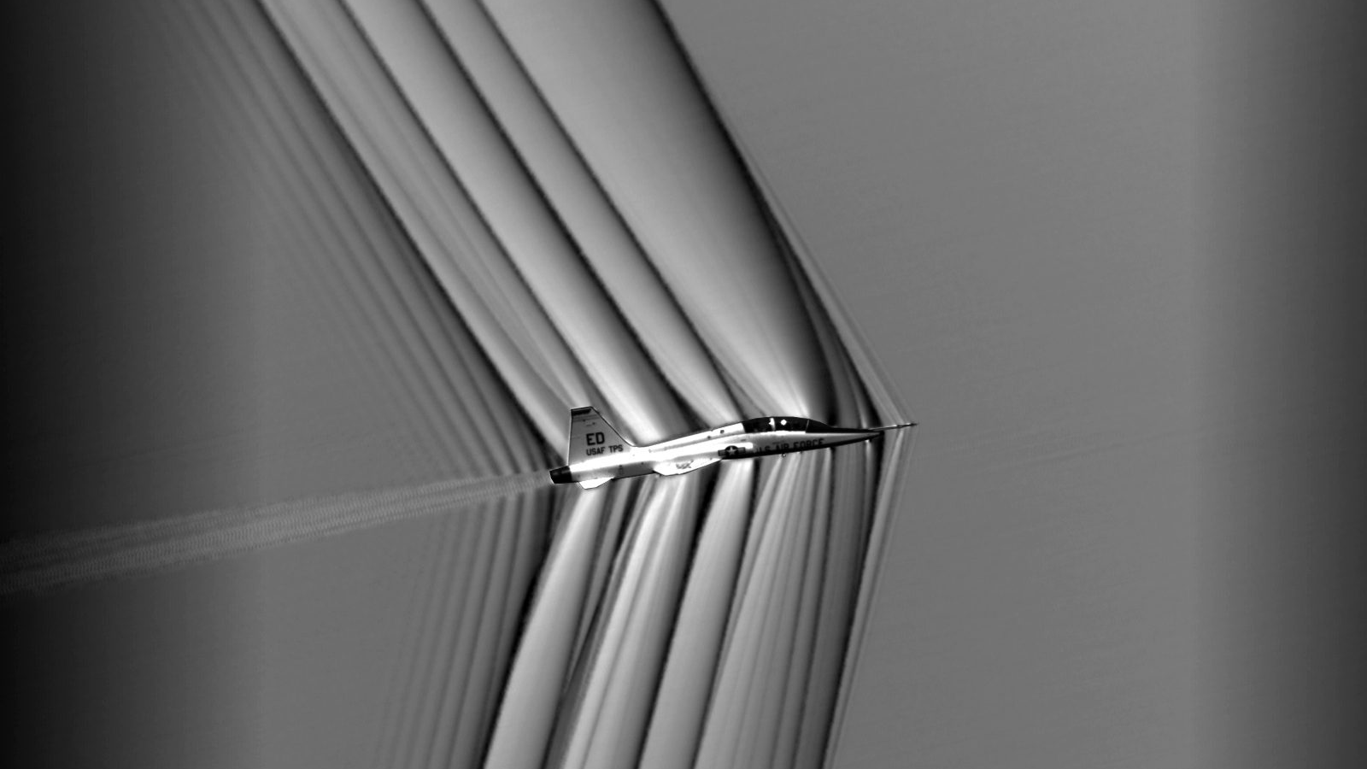
Volatus Calculator Ad Stera per mathema
Cristian Rosete

Slide 2
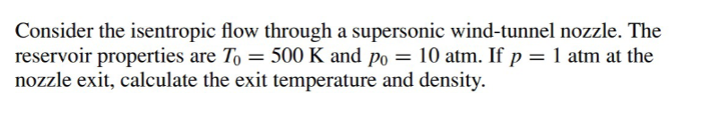
Goal:
Student Calculator:
Calculate the Air Density Given Initial Temperature and Pressure
Calculate the Temperature or Pressure given a Mach number
Calculate the Exit Temperature and Pressure with initial Temperature, Pressure and Mach number

Slide 3
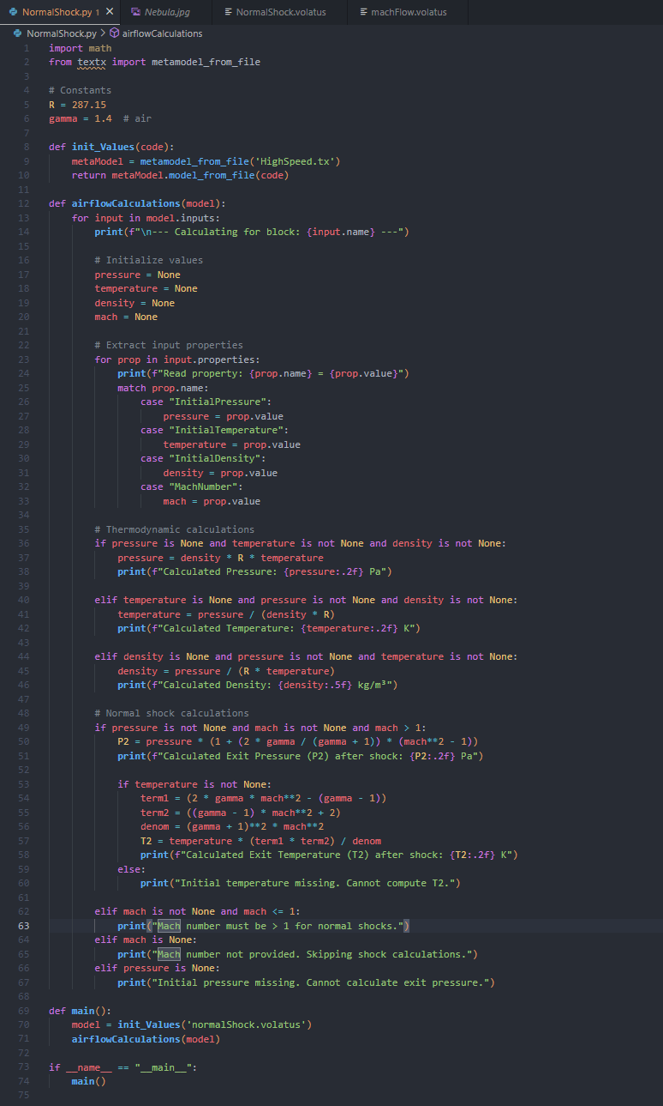

Interpreter

Slide 4
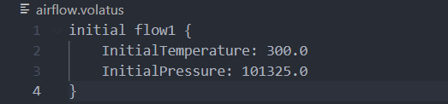
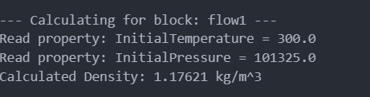
airflow.Volatus

Slide 5
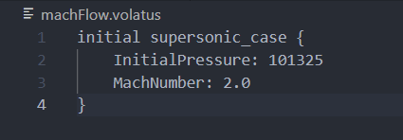
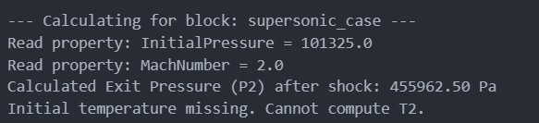
machFlow.Volatus

Slide 6
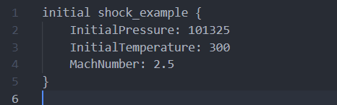
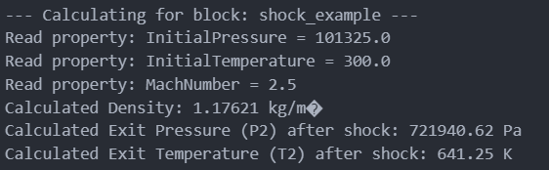
normalShock.Volatus

Slide 7
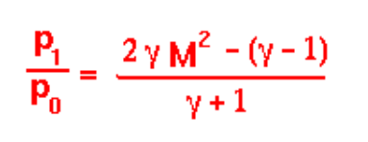
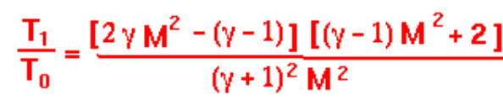
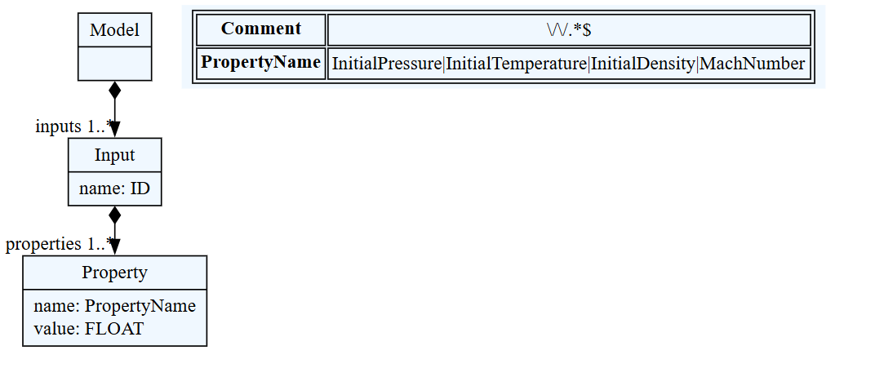
Appendix
Governing Equations

